Slide 1
Risk Assessment Model
MSMA Group #33
Ya Liu
Mingwei Tu
Yuchen Yao
Yingyuan He
Bojian Zhang

Slide 2
1
Model Development

Slide 3

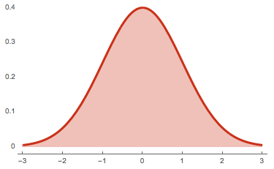

Prepare data——Data Scaling
If we left magnitudes of features alone, these algorithms only take in the magnitude of features neglecting the units.
The features with high magnitudes will weigh in a lot more in the distance calculations than features with low magnitudes.
To suppress this effect, we need to control all features on the same level of magnitudes. This can be achieved by scaling.

Slide 4
Prepare data——Special Values
-9 No Bureau Record or No Investigation
No record means no credit history/score information is available.
-8 No Usable/Valid Accounts Trades or Inquiries
Usable or valid for Accounts/Trades means inactive, or very old.
-7 Condition not Met (e.g. No Inquiries, No Delinquencies)
“Condition not met,” which implies that the feature/variable searched for a certain event’s occurrence in the data, and that event was not found.

Slide 5

Model selection
GridSearchCV
CV score
Best estimator

Slide 6
Model selection
Model | Best hyper-parameters | CV Score | Accuracy
Decision tree | max_depth=6, min_samples_split=6 | 0.70601 | 0.68872
Logistic regression | C=0.1, penalty='l2' | 0.71953 | 0.70822
KNN | n_estimators=100 | 0.71520 | 0.70746
SVM(linea) | C=1, gamma='auto_deprecated' | 0.72144 | 0.70784
SVM(poly) | C=1, gamma='auto_deprecated', degree=3 | 0.71252 | 0.70631
SVM(rbf) | C=1, gamma='auto_deprecated' | 0.72578 | 0.71778

Slide 7
Model selection
Bootstrap aggregation
Boosting
Improve accuracy
Model | Best hyper-parameters | CV Score | Accuracy
Boosting | learning_rate=1, n_estimators=30 | 0.72616 | 0.71281
Random forest | n_estimators=60, max_features=5 | 0.72743 | 0.70478
Bagging (SVM base) | max_features=0.6, max_samples=0.4, n_estimators=50 | 0.72769 | 0.71855

Slide 8
2
Interface Design

Slide 9
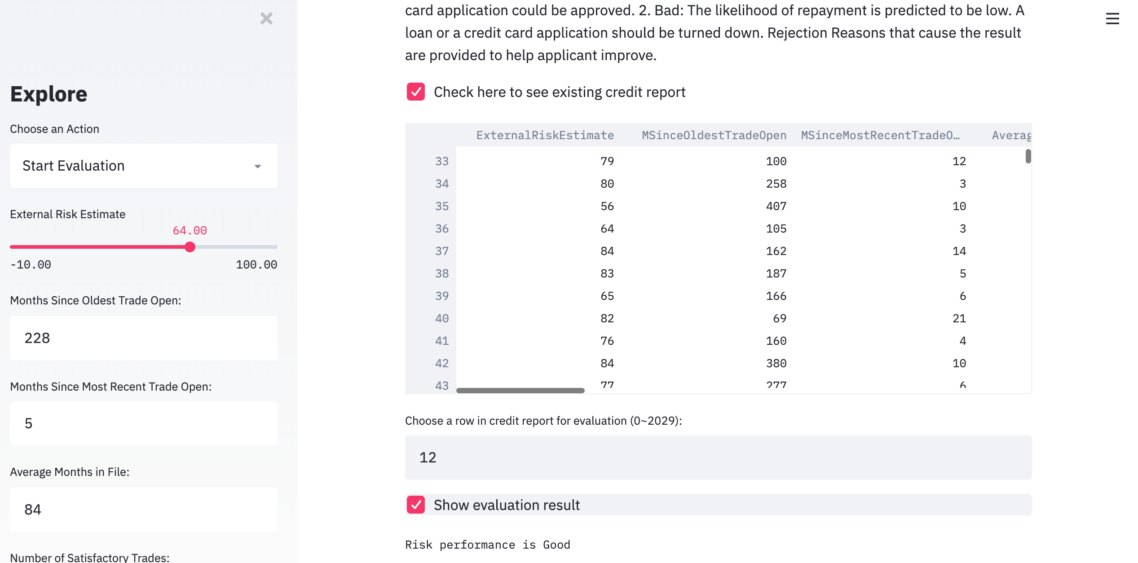
Interface Prediction Result

Slide 10
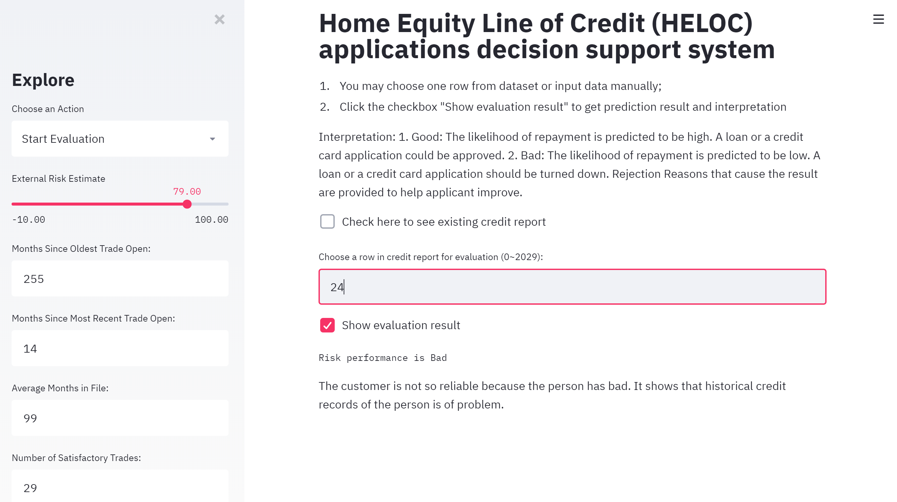
Interface Prediction Result

Slide 11

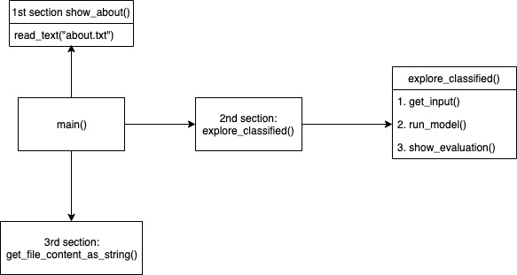
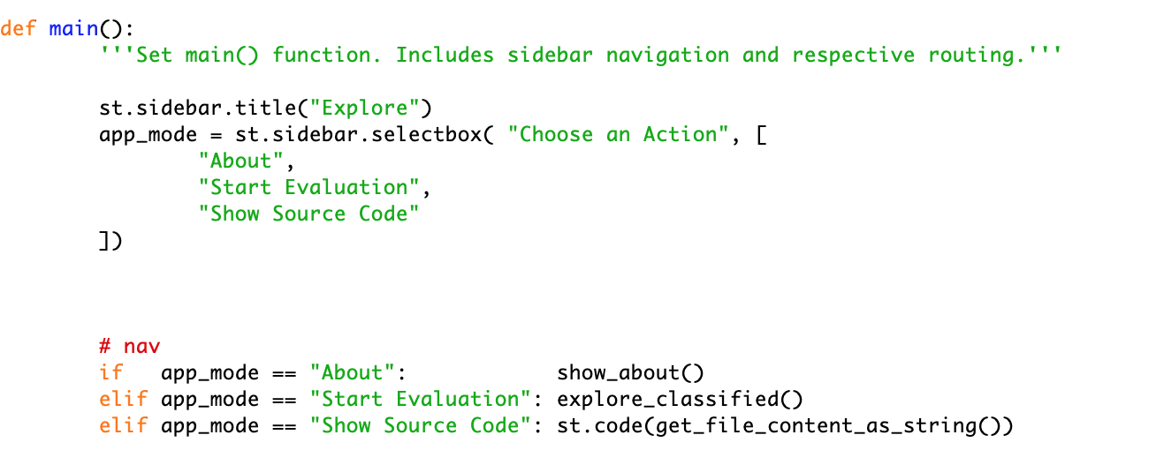
3 sections

Slide 12
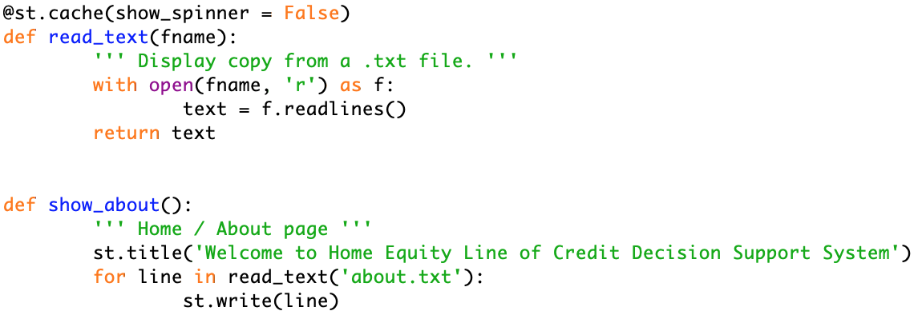
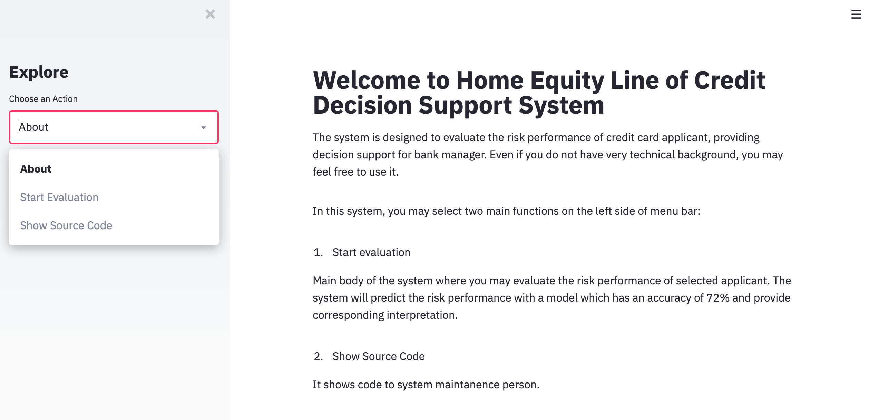
1st section show_about()

Slide 13
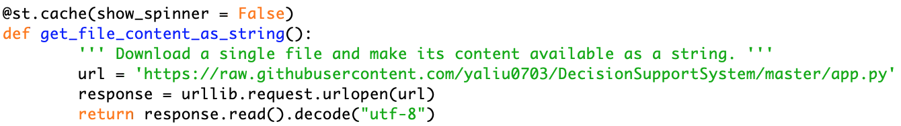
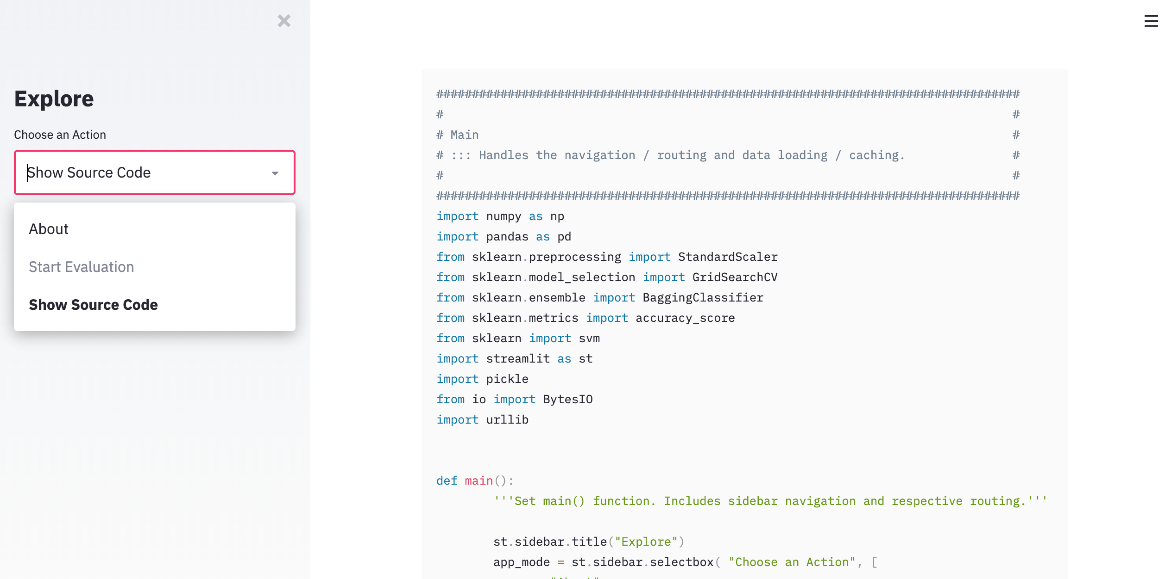
3nd section: get_file_content_as_string()

Slide 14
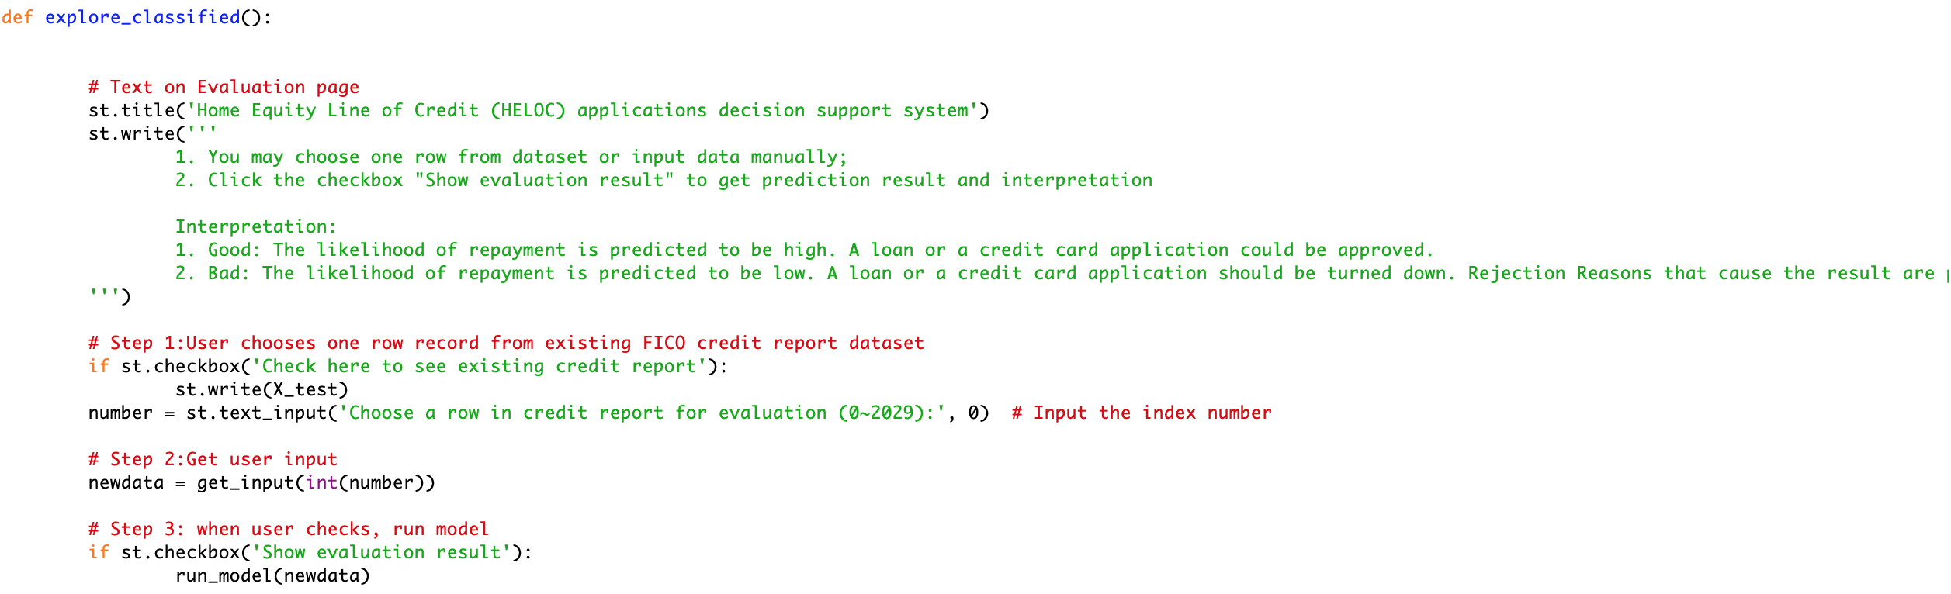
2nd section: explore_classified()

Slide 15
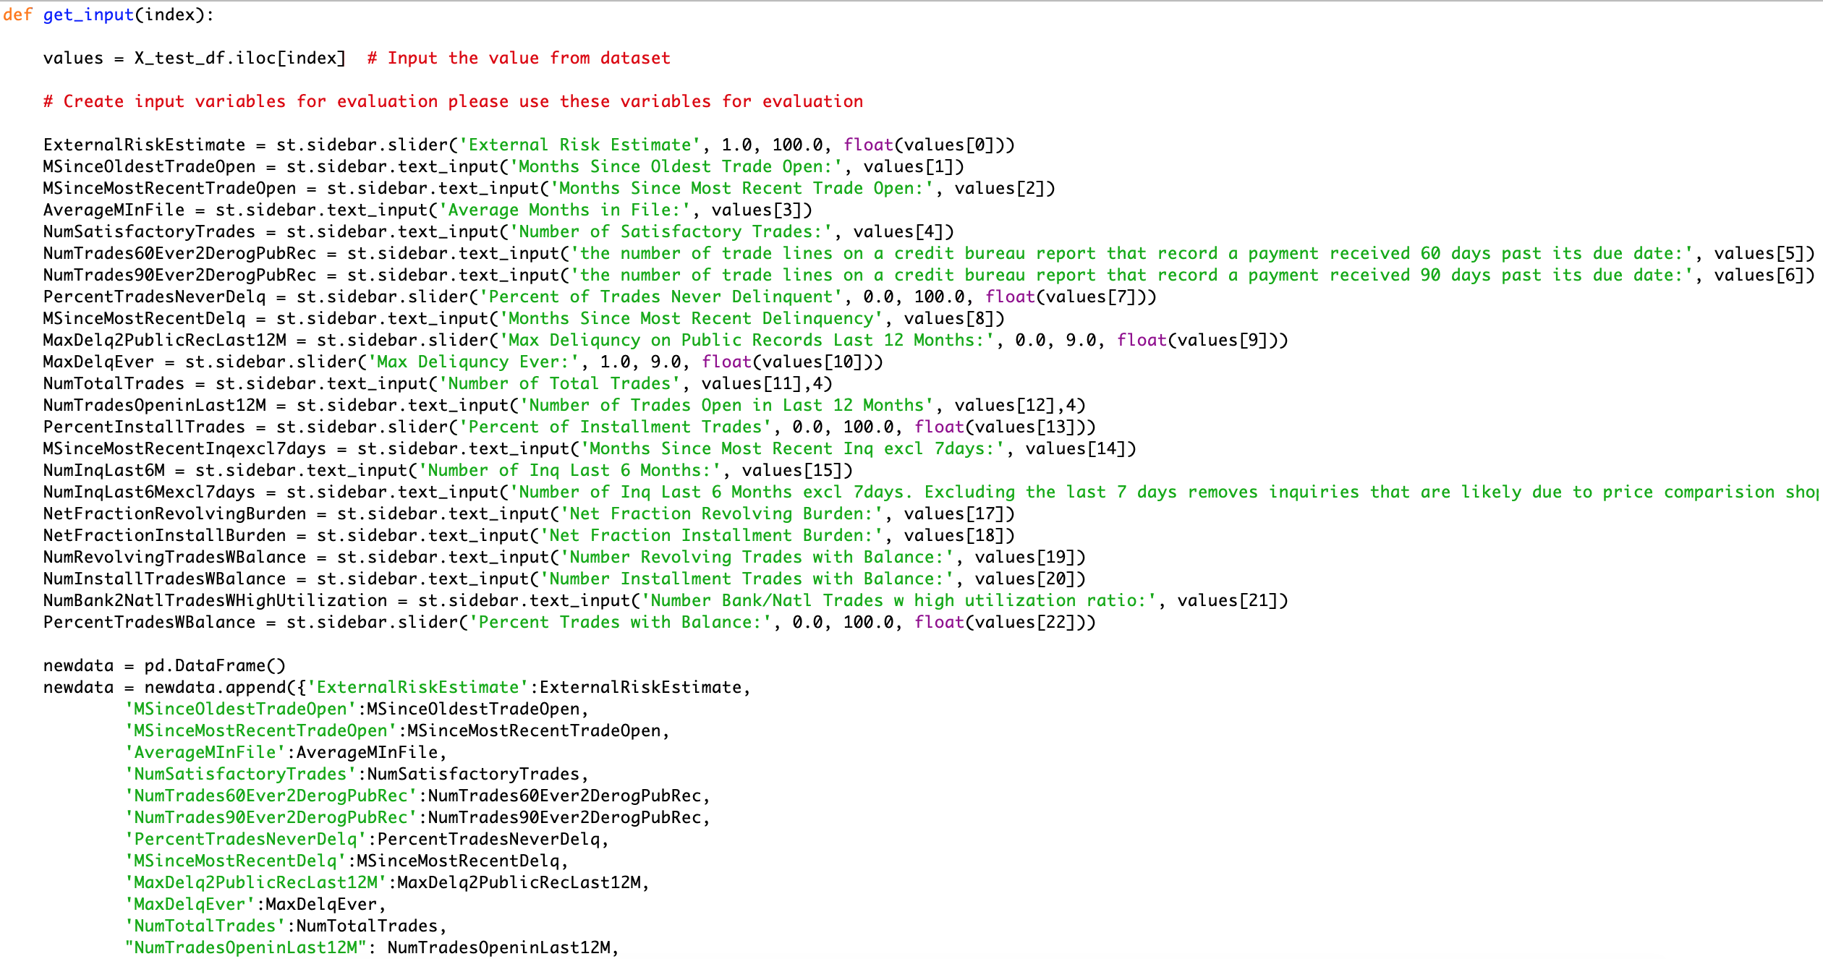
2nd section: explore_classified()

Slide 16
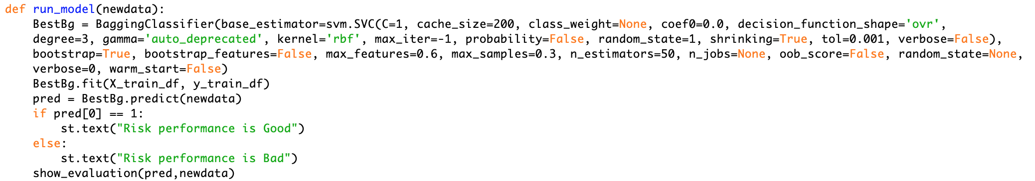
2nd section: explore_classified()

Slide 17
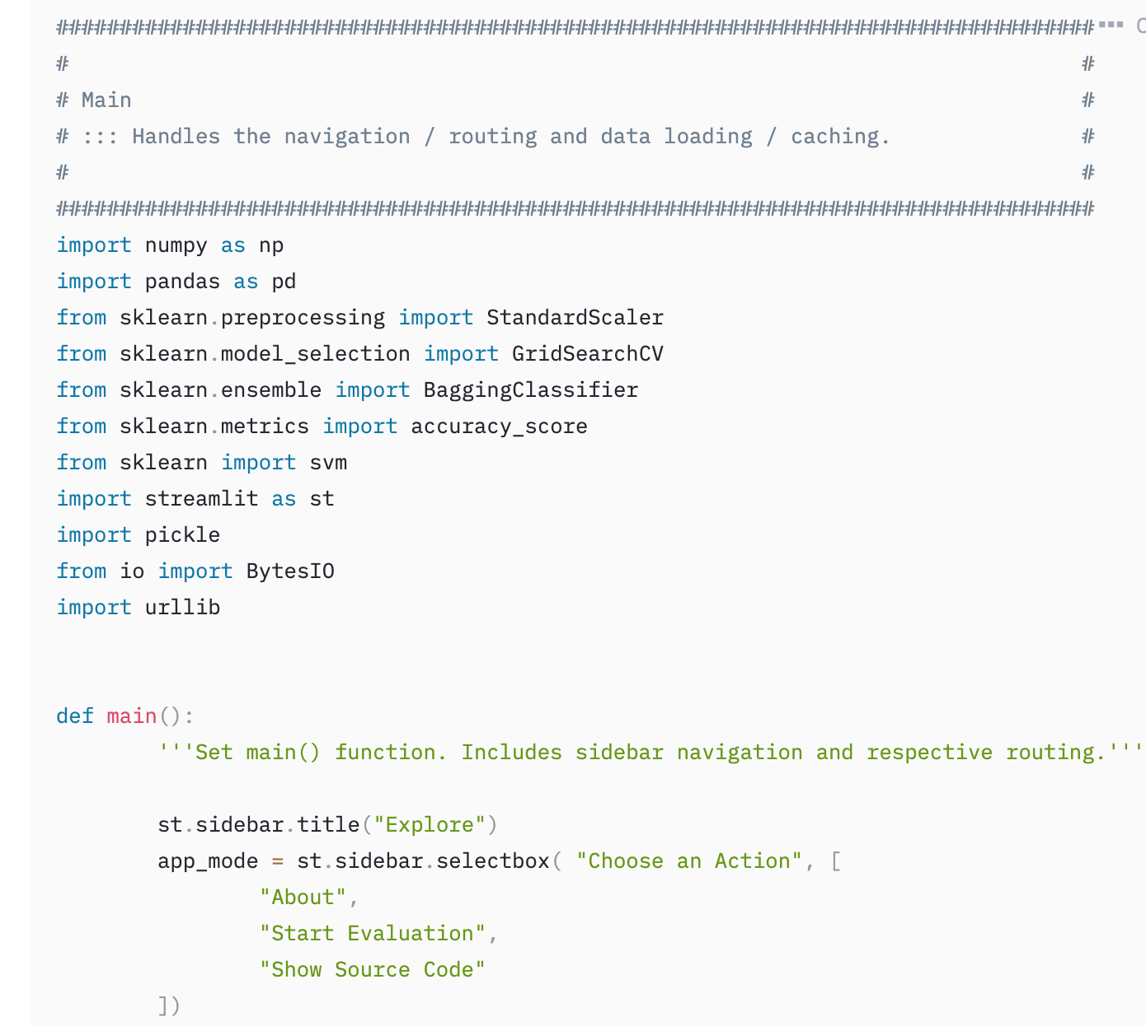
1st: show_about()
this is text

Slide 18


Interpretation
Prediction
trainstandard = {}
for colname in list(X_train_df):
num = []
mean = np.mean(X_train_df[colname])
std = np.std(list(X_train_df[colname]))
num.append(mean)
num.append(std)
trainstandard[colname] = num
Is it ‘Good’?
Print ‘Good’
Print ‘BAD’
Does this people have missing value?
Find the first three significantly far variables as reason
Warn the banker about the risk

Slide 19
Risk Assessment Model
MSMA Group #33
Ya Liu
Mingwei Tu
Yuchen Yao
Yingyuan He
Bojian Zhang

